Slide 1

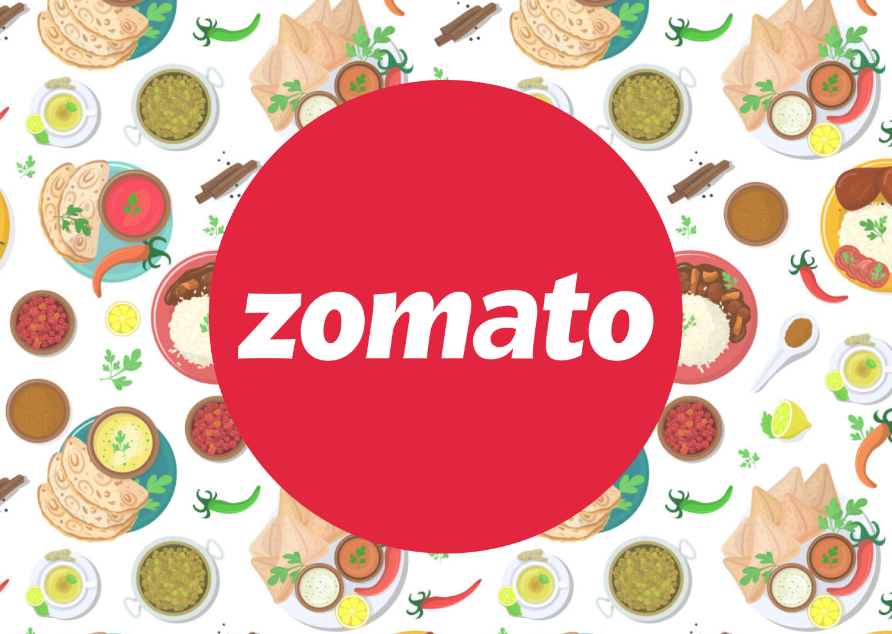
ZOMATO EXPANSION ANALYSIS
BY Tilak raj

Slide 2

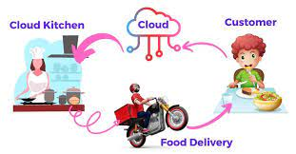
About ZOMATO
Zomato is a leading Indian multinational restaurant aggregator and food delivery company.
Founded in 2008 by Deepinder Goyal and Pankaj Chaddah .
company is currently located in Gurgaon, India.
Initially started as Foodiebay, later rebranded to Zomato in 2010.
Operates in over 20 countries, including India, UAE, Australia, and more.
🍽️ Zomato Services - Online Food Delivery , Zomato Kitchen (Cloud Kitchens).
Recent Developments: Expansion into grocery delivery and cloud kitchens, adapting to market trends has now increased chances of employment and engagement of the app and it’s services

Slide 3

Problem Statement
Identify countries and cities where there is less competition and a greater chance of new restaurant openings.
Analyze market trends like pricing, customer ratings, online delivery, and table booking preferences.
Examine the impact of price and cuisine varieties on customer ratings.
Deliver data based suggestion to open newer restaurants.

Slide 4
DATA OVERVIEW
Restaurant Identification – Each restaurant is uniquely represented by a Restaurant ID and Name.
Location Details – Includes Country, City, Address, Locality, and Locality Verbose for precise geographic placement.
Geospatial Information – Latitude and Longitude capture the exact coordinates of each restaurant.
Cuisine Information – Updated Cuisines specifies the type(s) of food offered.
Currency & Pricing – Currency, Price Range, and Average Cost for Two (both in local currency and INR) describe affordability.
Booking & Delivery Options – Fields such as Has Table Booking, Has Online Delivery, Is Delivering Now, Switch to Order Menu indicate service availability.
Popularity & Feedback – Votes (user engagement) and Rating (overall quality) measure customer response.
Opening Information – Date of Opening and Year track when a restaurant began operations.
Competitive Insight – Price and rating categories allow comparison across restaurants for identifying competitors.

Slide 5

METHODOLOGY AND Data analysis
Data Cleaning – Removed blanks (5%) and duplicates for accuracy.
Data Enrichment – Fixed inconsistencies, filled gaps, and mapped country codes to names via VLOOKUP.
Descriptive Analysis – Used pivots/charts to study ratings, votes, cuisines, and yearly openings to spot expansion regions.
Customer Preferences – Analyzed cuisine popularity by country/region using ratings and votes.
Restaurant Performance – Evaluated using average cost for two and ratings.

Slide 6
Country wise restaurants
Out of 9,551 restaurants, most are in India (8,652), followed by the USA (434), UK (80), and Canada (4).
India and the USA are saturated, while Canada offers high growth potential due to fewer establishments.

Slide 7
Year wise Restaurants count
2011 marked the highest growth, with 1,098 new restaurants.
2012 saw a sharp decline, after which growth remained inconsistent.
From 2015 onward, openings stabilized with steady increases.
A major spike in 2017 signaled renewed momentum.
Overall trend shows sustained demand and strong future potential.

Slide 8
Average Votes Country wise
India has the most restaurants but fewer voters.
Indonesia leads in voter count, followed by UAE.
Turkey stands out with only 40 restaurants yet 431 average voters.
USA shows low voter engagement, similar to India.

Slide 9
Correlation b/w Rating and Average Cost
Target markets: Countries with ratings 3.1–4.0, low restaurant count, and high voter engagement.
Recommended for expansion: Philippines, Indonesia, Turkey and Canada.

Slide 10
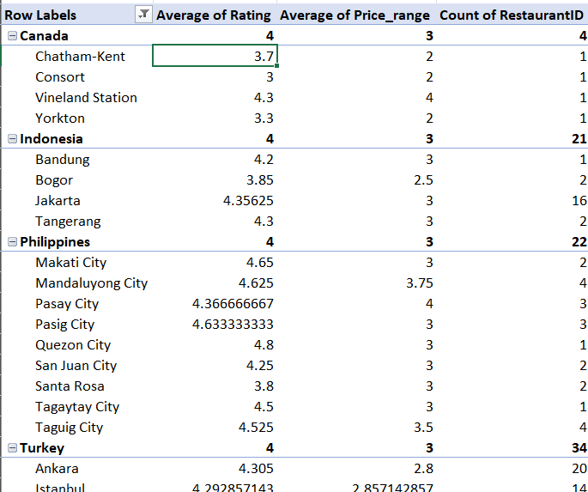
Pinpointing Promising Cities
Selected cities have few restaurants but high ratings and strong customer engagement, making them ideal for expansion.
Top City recommendations :
Canada : Vineland Station, Chatham-Kent
Indonesia : Bandung, Tangerang
Philippines : Quezon City, Tagaytay City, Pasig city
Turkey : Ankara, Istanbul

Slide 11
Impact of Services on Ratings
Coming onto the rating of restaurants, the restaurants which have online delivery and table booking have slightly better avg ratings when compared with those who doesn’t have.
This factor proves that having online presence not only caters to more no. of people also increases the overall rating.

Slide 12
Impact of Services on Ratings
My analysis of data shows a clear trend : restaurants that offer online delivery and table booking consistently have higher average ratings.
This presents a golden opportunity to stand out from competition and enhance customer satisfaction by implementing these features.

Slide 13

Country wise Ratings
The below figure shows the average for each country. India has the lowest rating whereas Philippines and Indonesia has highest rating comparatively

Slide 14
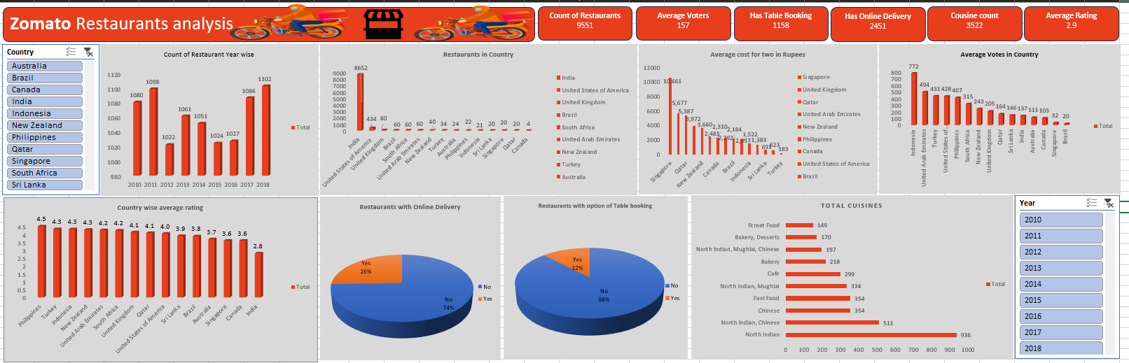
DashBoard

Slide 15
Key Findings
Target Countries: Philippines, Turkey, Indonesia, Canada – low competition, high sales.
Target Cities: Quezon City, Ankara, Bandung, Vineland City.
Cuisine Focus: Popular & highly-rated cuisines – Japanese, Indonesian, Mexican, American, Indian, Desserts.
Service Enhancement: Offer online delivery and table booking for a competitive edge.
Pricing Strategy: Focus on quality and service rather than price cuts.

Slide 16
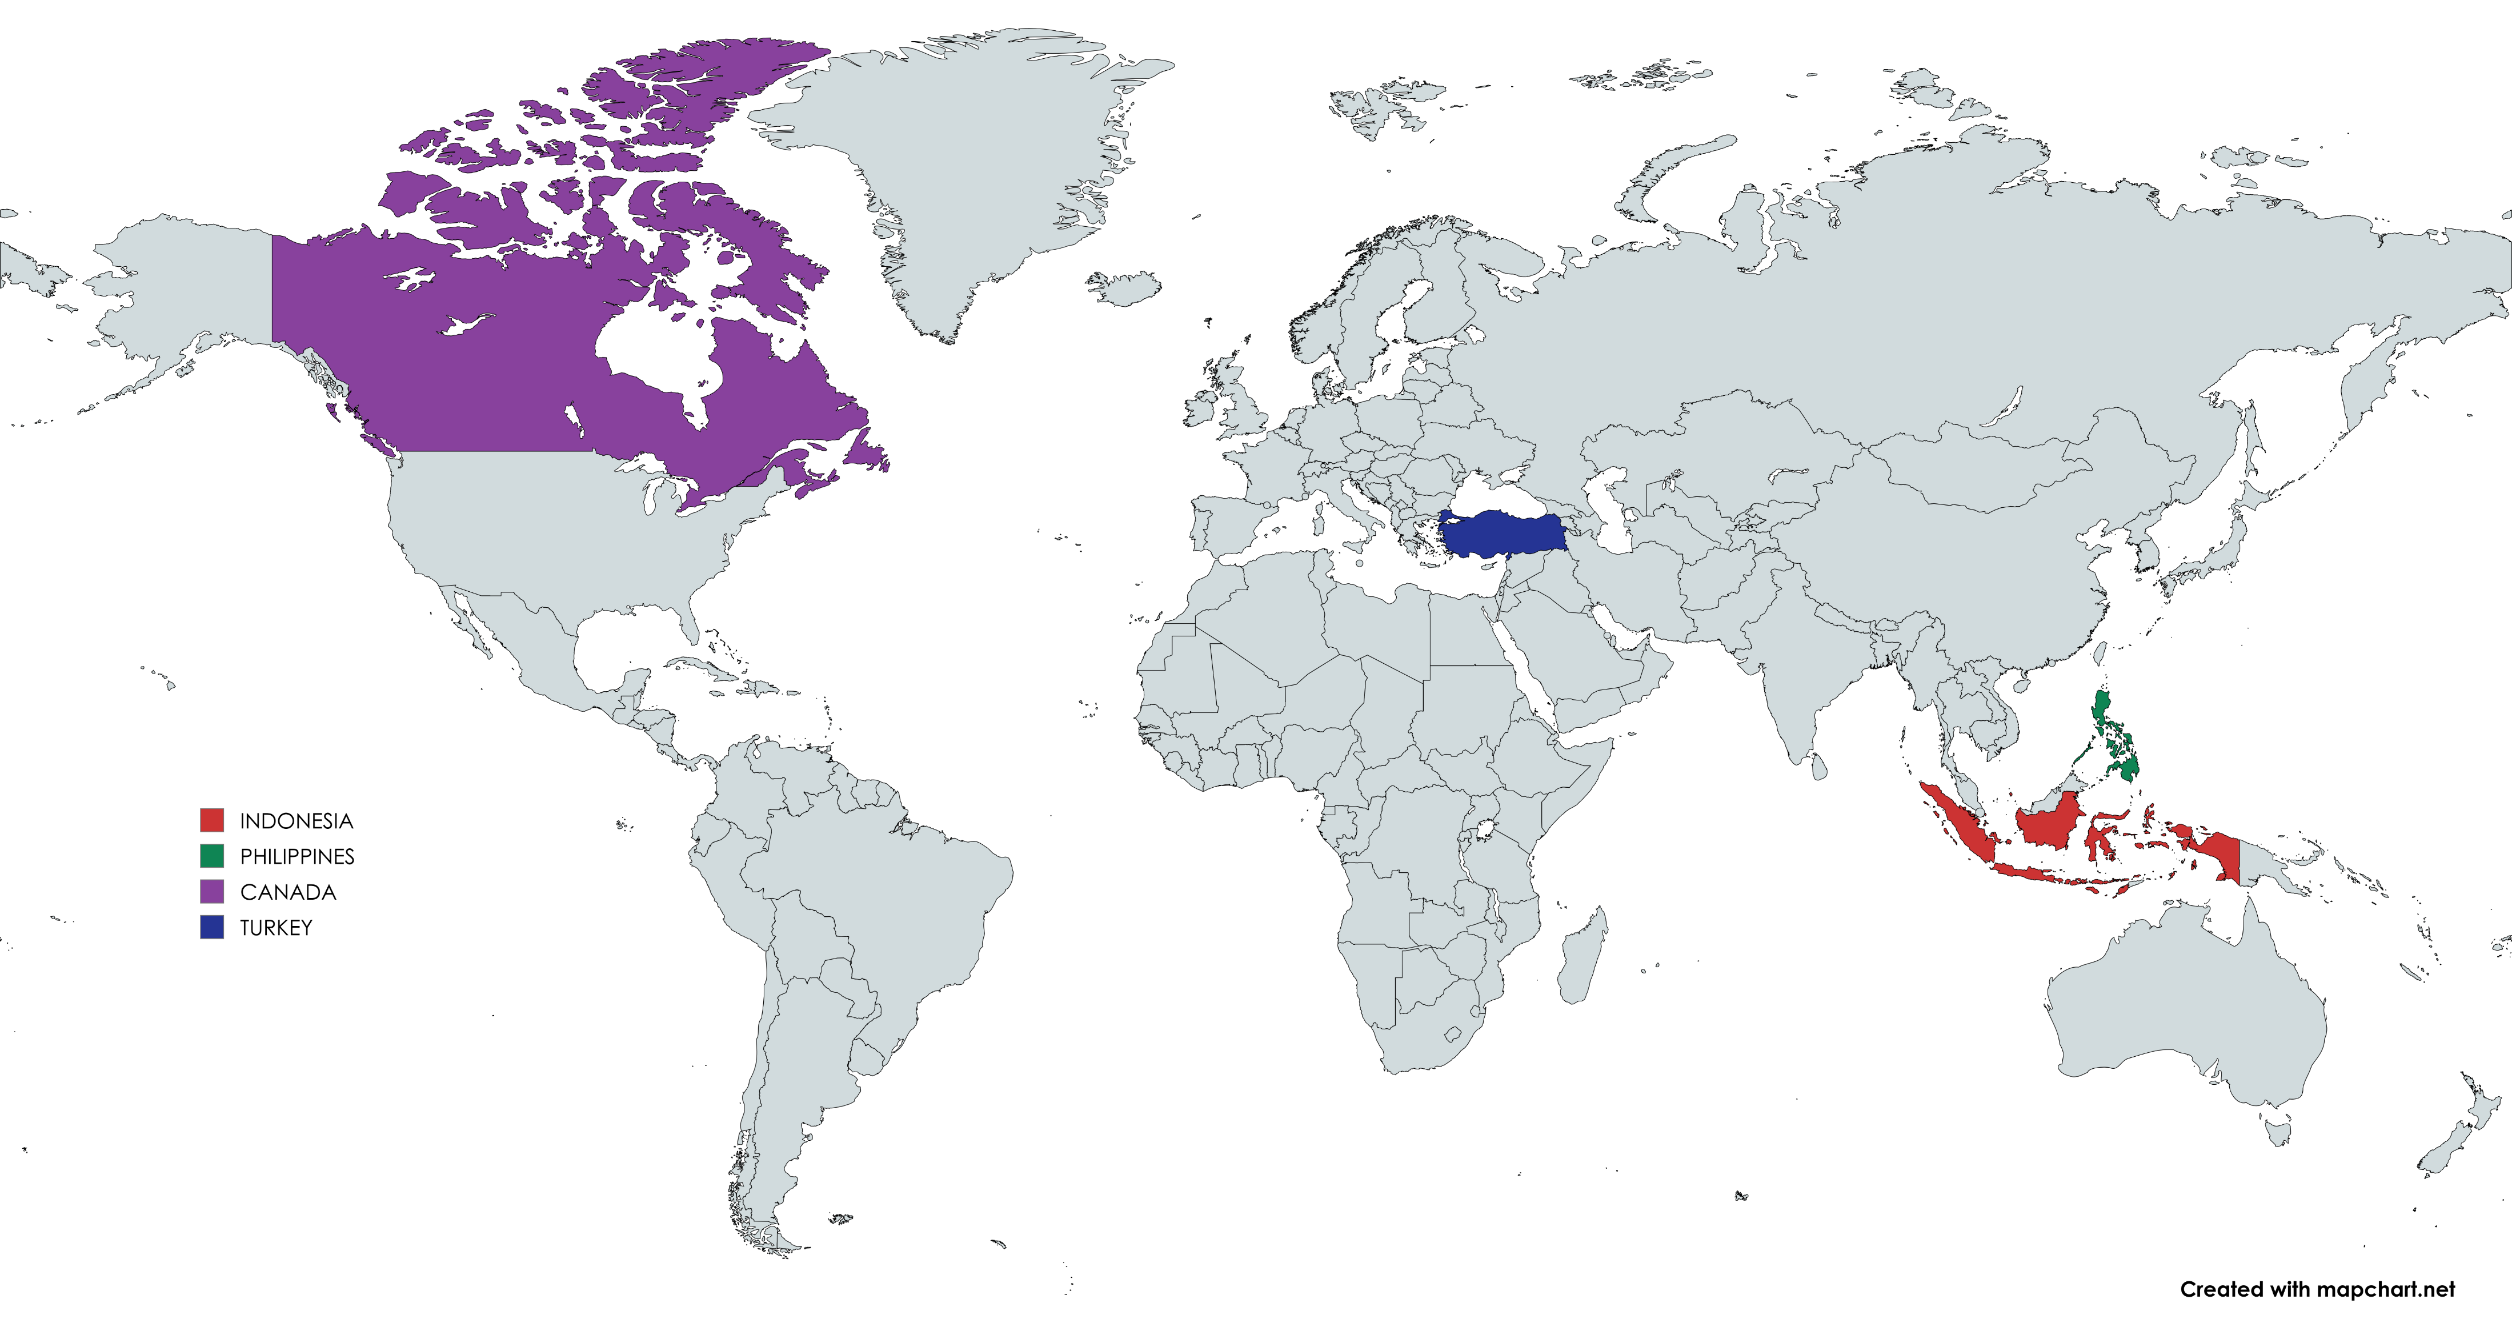
Recommendations
Best Countries to Open new restaurants are:
Indonesia
Philippines
Canada
Turkey
These are the countries recommended after checking through various factors like Low competition, High demand and strong ratings.

Slide 17


Thank you

